Slide 1


Microsoft – CEP Gaming “Lionfish”
Who They Are?
The Xbox Gaming Studios group comprises Microsoft internal game development, as well as that of 15+ subsidiary groups.
What We Did
Affirma developed an interactive SharePoint Portal that allowed every employee to learn about the requirements that comprise the studios key “pillars” and ensure games in development were in compliance with the organizations best practices.
Implementation
Developed SharePoint sites for the four key pillars, all of which hosted dynamic information such as external tools, detailed requirements, and collaborative documents.
Content on these pillar sites integrated with an existing Azure DevOps Environment.
Utilized new (at the time of release) SharePoint Framework Web Part technology to retain the look-and-feel benefits of new SharePoint Modern sites while gaining a large degree of customization.
Configured a highly-customized search and permissions structure, ensuring sensitive data remained secure while allowing users to easily find the content they needed.

Slide 2
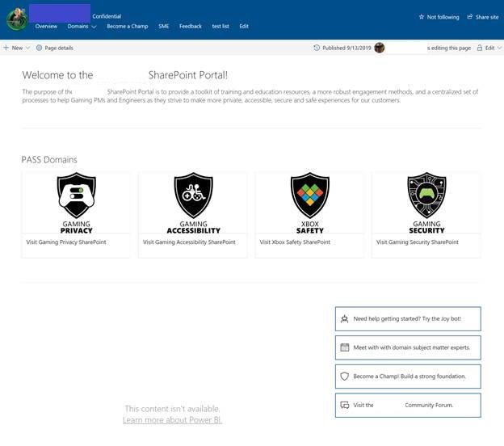
Microsoft – CEP Gaming “Lionfish” Screenshot

